Slide 1

Mini Project-1
Presented By The Team Triumph

Slide 2
Group Members
Rabbi Awan
Ibrahim Moeed

Slide 3
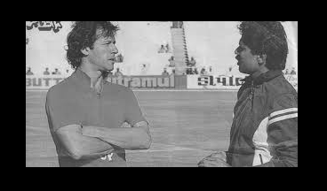
Original Image(For Reference)

Slide 4
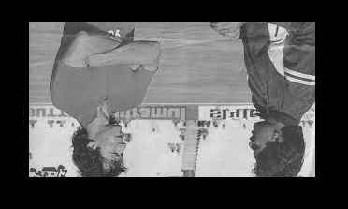
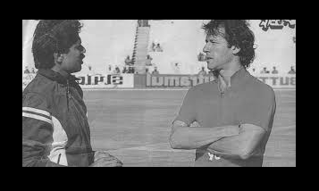
Flip Horizontal And Vertical
Horizontal
Vertical

Slide 5

Rotation Of Image
Rotation By 90 degree

Slide 6
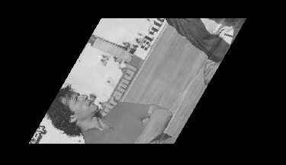
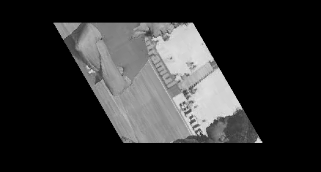
Rotation of Image(Forward and Backward)
Rotation by any angle(60 deg)
Rotation By Any Angle(-60 deg)

Slide 7
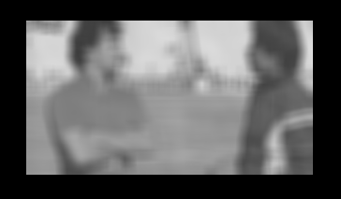
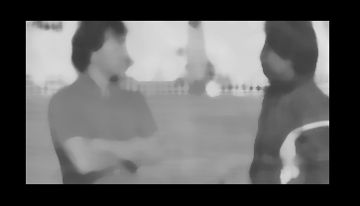
Applying Filters
Mean Filter(Input Value: 12)
Median Filter(Input Value: 10)

Slide 8
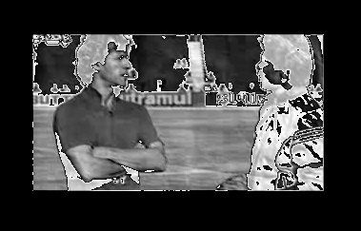
Linear Filter
Before
After

Slide 9
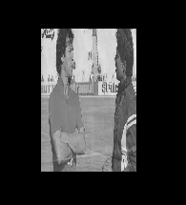
Resizing an Image
Before
After

Slide 10
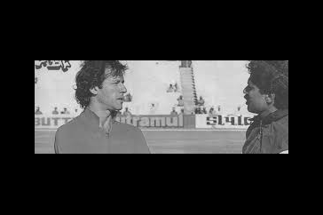
Translating An Image
Before
After(20,30)

Slide 11
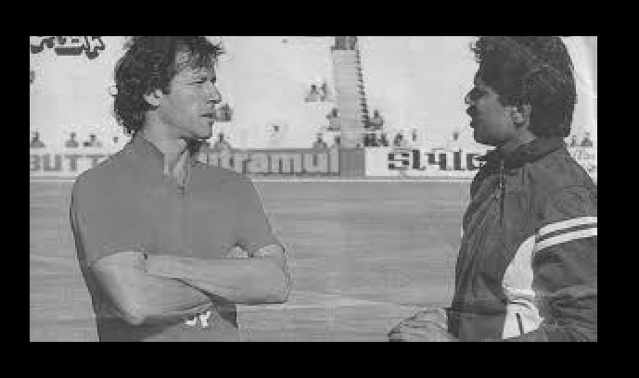
Scaling An Image
Before
After(Scale Factor: 2)

Slide 12

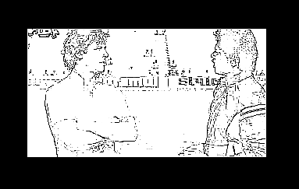
Brightness And Sharpness
Brightness
Sharpness

Slide 13
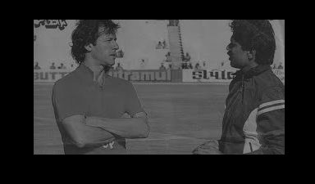
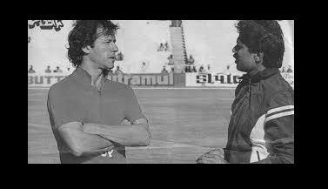
Shrink and Contrast
Shrink
Contrast

Slide 14

Find Edges
Before
After

Slide 15
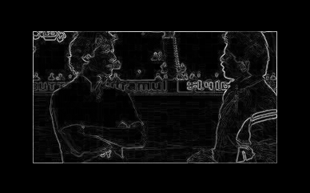
Derivative Filter
Before
After

Slide 16
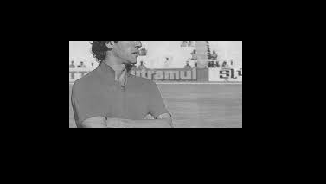
Crop Image
Before
After

Slide 17
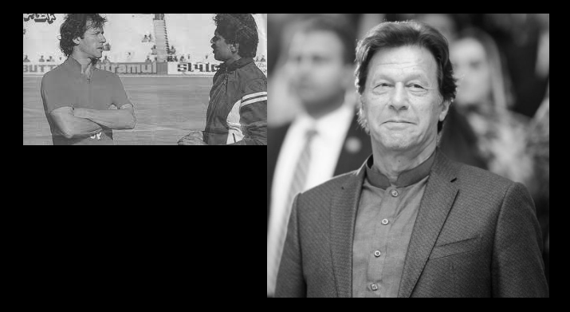
Image Side By Side
Before
After

Slide 18
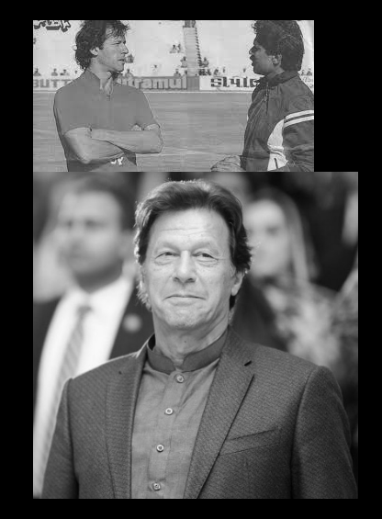
Image Top To Bottom
Before
After

Slide 19
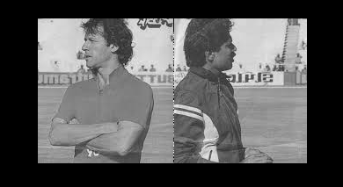
Image Reverted(Bonus)
Before
After

Slide 20
Challenges Faced
Algorithm Comprehension Challenge: We, especially newcomers to image processing, find it difficult to grasp the mathematical concepts and algorithms behind operations like filtering, rotation, and contrast stretching.
Code Implementation: Translating theoretical knowledge into practical code is a hurdle, especially for complex operations, requiring a deep understanding of algorithms and precise coding.
Organizing The Code: Breaking down the code into manageable and modular components is crucial for readability and maintainability. Students may face challenges in designing a well-organized code structure, especially as the functionality of the program grows.

Slide 21
Conclusion
The provided code delivers a versatile image processing application with a user-friendly interface.
The code encapsulates image-related functionalities within the Image structure and menu-related features within the menu structure, promoting readability and maintainability.
The inclusion of diverse image processing operations, from basic manipulations to advanced techniques, showcases a comprehensive understanding of image processing concepts.
However, there is room for improvement. Strengthening error-handling mechanisms will enhance the program's resilience, providing users with informative feedback.
Scalability considerations are crucial, especially for handling larger images, necessitating optimization for efficient memory usage and computational processes.

Slide 22
THANK YOU!

